Slide 1
SNOMED-ifying a (mostly) Free-Text Medical Record
Chris Brandt, DVM, MS, PMP
UC Davis School of Veterinary Medicine

Slide 2
Agenda
VMACS Coding History
Coding Project Startup
Mapping
Species / Breeds
Drugs
Procedures
Dx Test Results
Clinical Dx - Demonstrate our procedure for the mapping of these concepts and our guidelines for when to map and when not to map.
Collecting coded Clinical Dx direct from Clinicians

Slide 3
Learning Outcomes
Be able to self-assess institutional readiness to attempt conversion to the OHDSI Common Data Model Understand pros and cons of selecting different vocabularies for mapping institutional concepts.
Understand the value in using the OHDSI Common Data Model over a custom schema.

Slide 4
UC Davis Coding History
6 Coders (3 SA / 3 LA)
Species / Breed / Diagnosis
To send to VMDB
Discontinued in the mid-1990s
Free text search was superior
~2015 - We want to start coding – but how?
And Then… COHA 2018
Notes:
Historically, the VMTH had a set of approximately 6 coders (3 in small animal / 3 in large animal) who worked to document codes for the diagnosis, species, and breed in each patient record. This data was sent to the Veterinary Medical Database (VMDB), a multi-institutional veterinary medical data aggregate, to promote advanced search tools for clinical observational research. This was discontinued in the mid-1990s because the coders were years behind in completing the task, and our local free text search was superior to what VMDB offered.

Slide 5
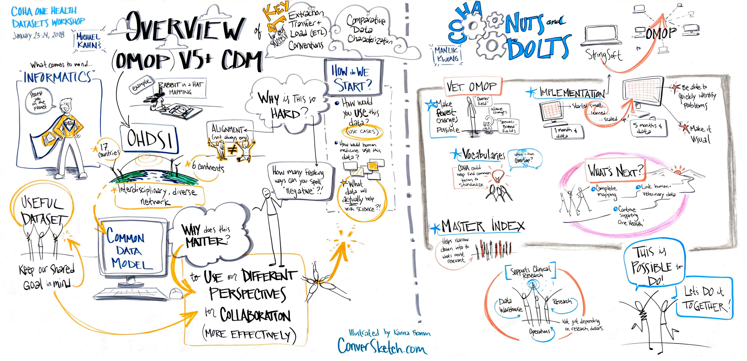

Slide 6
Timeline
Feb 2018 – COHA @ CSU
Oct 2018 – OHDSI Symposium
Nov 2018 – Coding Project Charter

Slide 7
“Coding Project” Objectives
Deliver coding capabilities in VMACS to support research on patient visits, drug prescriptions, and performed procedures. The objective is to develop infrastructure and tools which support a Common Data Model (CDM) to allow large-scale observational research.

Slide 8
“Coding Project” Requirements
Develop a Common Data Model (CDM) to store
Patient demographics
Visit dates / types
Billed procedures
Drug administration
Allow repeated re-harvesting of VMACS data into CDM as procedure/drug mapping improves.
Design the system for eventual collaboration with other academic and commercial institutions for both research and medical record sharing.

Slide 9
“Coding Project” Requirements
Update VMACS to store standard ontology codes
Mapping
Breeds / Species - SNOMED
Procedures – SNOMED
Drugs – RxNorm
Why These Ontologies?
Notes:
3500 Procedures
2700 Drugs
2700 Breeds

Slide 10
Project Philosophy
Do what we can without requiring faculty input / effort
Build a proof of concept with procedures/drugs/breeds
Share a vision of what is possible with adding lab data and clinical diagnosis
AND Multi-Institution – OMG!

Slide 11
VELOCITY
VEterinary Leverage of Ontology for Clinical InformaTics discoverY

Slide 12
Building the Team
Medical
Dr. Allison Zwingenberger
Dr. Krystle Reagan
Dr. William Vernau
Danielle Holt
Technical
Scott Fischbein
Moon Bae
Nicholas Ilacqua
Dr. Chris Brandt

Slide 13
Timeline
Feb 2018 – COHA @ CSU
Oct 2018 – OHDSI Symposium
Nov 2018 – Coding Project Charter
Dec 2018 – Initial ATLAS Install @ UC Davis
Feb 2019 – COHA @ CSU
Feb 2019 – Inclusion of Veterinary Extension in Athena
Apr 2019 – Procedure Mapping @ VTSL
October 2020 – Virtual COHA Conference

Slide 14
Parallel Processes
Mapping Procedures / Breeds / Drugs
OHDSI Infrastructure
VMACS Updates
Monthly technical meeting with PoC Team since October 2019
Initial Extract / Transform / Load

Slide 15
Procedures Mapping – SNOMED April 2019
Veterinary Terminology Services Laboratory @ Virginia Tech – VTSL
Dr. Jeff Wilke & Dr. Julie Green
1 Week immersion training
Mapping with the VTSL SNOMED Browser
Mapping prioritization
Total vs. utilization count
No billing-specific codes

Slide 16
Procedure Mapping

Slide 17
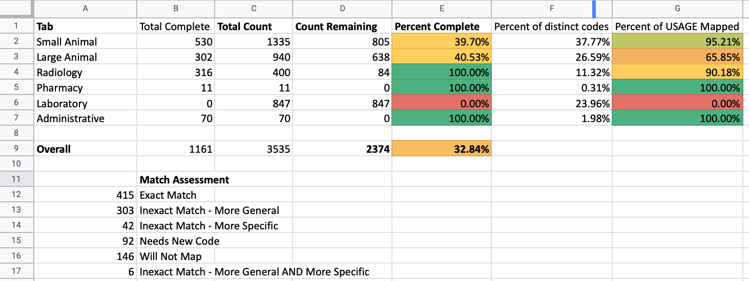
Procedure Mapping

Slide 18
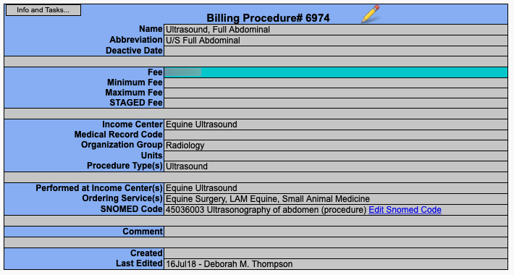
Procedure Mapping

Slide 19
Mapping - Drugs
Mapped with RxNav - https://mor.nlm.nih.gov/RxNav/
~2,700 Entries
Mapped to the Ingredient ID
Mapped to the Formulation ID
Handled by pharmacy staff

Slide 20
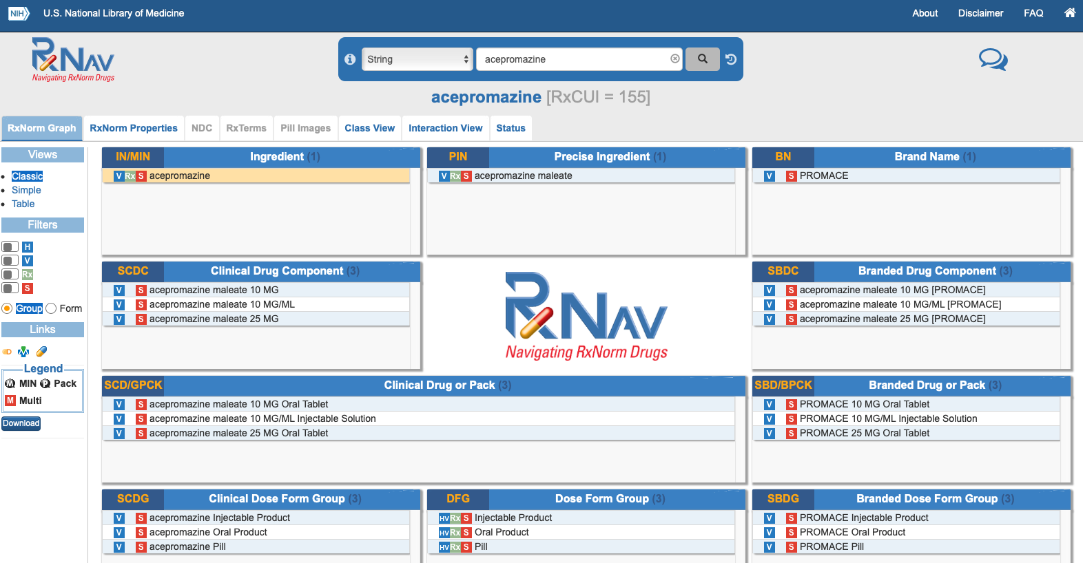

Slide 21
Mapping – Breed / Species
Breed / Species Mapping
~2,700 Initial Entries
OHDSI Usagi Tool

Slide 22
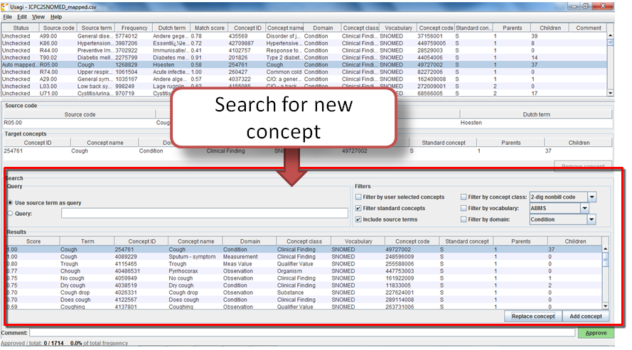

Slide 23
OHDSI Infrastructure
Windows VM
Tomcat / R / WebAPI / Tools
Microsoft SQL Server
ATLAS - https://atlas.ohdsi.org/
Web-based, open-source application developed to support the design and execution of observational analyses to generate real world evidence from patient level observational data. Atlas is an open science analytics platform that can be installed locally within your institution to perform analyses across one or more observational databases which have been standardized to the OMOP Common Data Model V5 and can facilitate exchange of analysis designs with any other organizations across the OHDSI community who have adopted the same open science community standards and tools.

Slide 24
Extract / Transform / Load – The Book of OHDSI https://ohdsi.github.io/TheBookOfOhdsi/

Slide 25
ETL Mapping

Slide 26
ETL Process
Harvest From VMACS to SQL Server
Minimal Transformation
Transform to CDM Format and insert into CDM

Slide 27
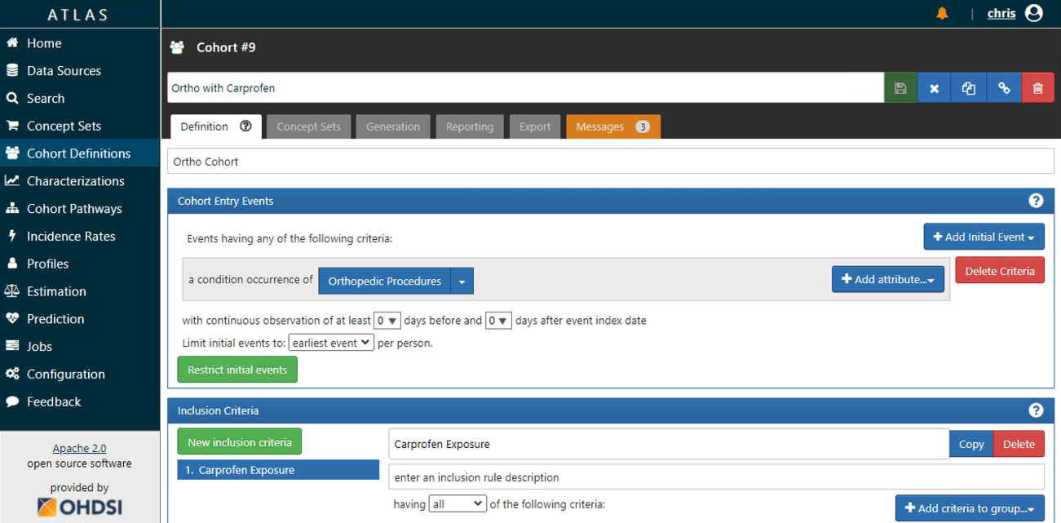

Slide 28
OHDSI Trials and Tribulations
Achilles
Documentation around R not ideal for novices
Mismatch for database / DDL
Running on 32-bit/64-bit R / Java -- discussion for solution in forum thread
SQL Server not a first-class citizen / incomplete testing
Recommendation
Valuable to have more interaction with the researchers to have sample cohorts to validate how the system should work
Data Validation
Lots of little issues & frustrations

Slide 29
Playbook – Data Import and Validation Guidelines
Requirements
Data Discovery
Data Mapping
Extract, Transform, Load (ETL)
Testing and Validation

Slide 30
Self –Assessment – Are you ready?
Do you have access to your data?
Is it stored discretely? Can you change how it is collected/stored?
Are your concepts mapped to standard ontologies?
Do you have the staff/expertise to perform this mapping?
Do you have staff to configure servers and start working on the ETL?

Slide 31
ETL Philosophy
UCD Health
UC Davis SVM

Slide 32
October 2020 Status
ETL Includes 10 years of data
Patient (breed/species)
Visit
Procedures
Drugs
Specific lab tests (with shim)
Test and Production ATLAS Servers
Basic AuthN/AuthZ

Slide 33
Coding Project – Phase 2 December 2020
Clinical Diagnosis Coding

Slide 34
Coding Project – Phase 2 December 2020
Add Clinical Diagnosis coding capabilities to VMACS
Map retrospective data and pull into our CDM
Store SNOMED codes alongside free text diagnosis
Build tool to leverage 3rd party SNOMED Browser/Search API
Add Clinical Pathology Tests to our ETL
Pull LOINC-coded results
Refine Playbook guidelines in support of initial studies
Improved AuthN/AuthZ

Slide 35
Second Phase – Clinical Diagnosis
Clinical Diagnosis is required to finalize the record

Slide 37
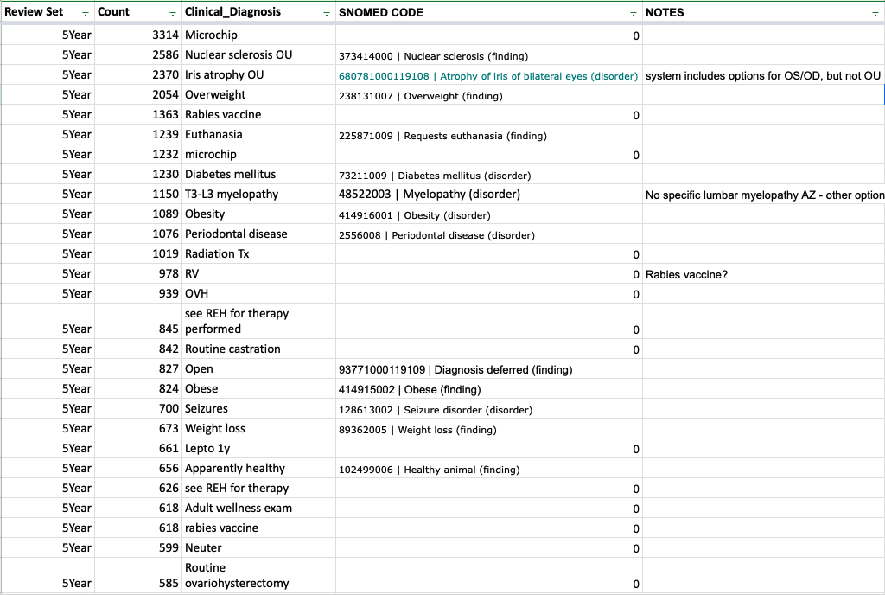
Encoding frequent Clin Dx to SNOMED is possible
Top 1000 Clin Dx by frequency of use
Last 5 Years
Last 20 Years
Top 50 from each service
1,664 Distinct Clinical Dx
352 (21%) were procedures and documented as ‘Will Not Map’

Slide 38
Encoding frequent Clin Dx to SNOMED is possible
Result = 25% of Clinical Diagnoses encoded for 2000-2019
1.6M Clinical Diagnoses
741,000 Distinct Clinical Diagnoses
412,844 of the CDs mapped
740K entries (~46%) are used 1-2 times total

Slide 39
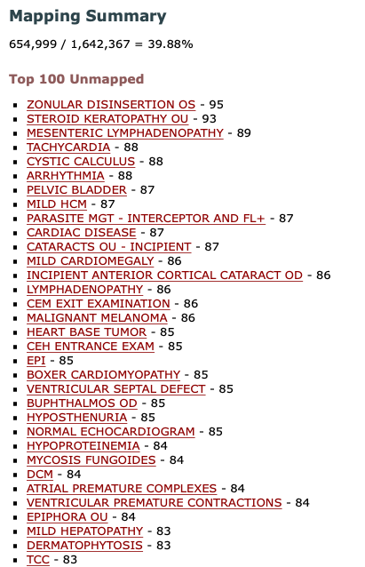
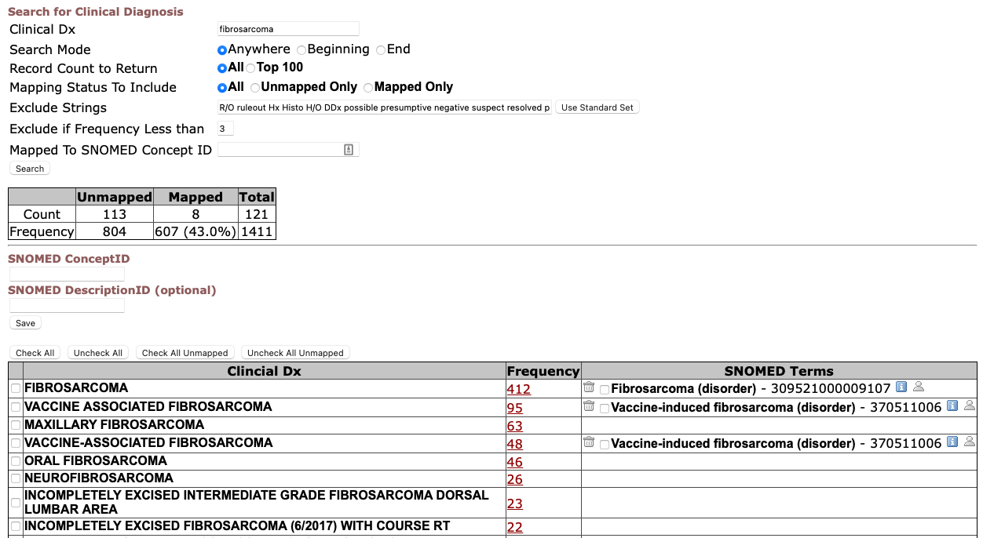
Getting from 25% to 50%

Slide 40
Prospective Clin Dx Coding = Registry
Retrospective Coding
Prospective Clin Dx Coding
Myelopathy
Myelopathy
Pyoderma
Pyoderma
Diarrhea
Diarrhea
Hepatopathy
Seizures
Diabetes
Pancreatitis
Pneumonia

Slide 41
Prospective Clinical Coding in VMACS
Design and refine a process that is quick and easy
Preserve the written text to capture specific meaning beyond the label
Reap the rewards in future
Quick identification of cohorts for research
New ways to display clinical data

Slide 42
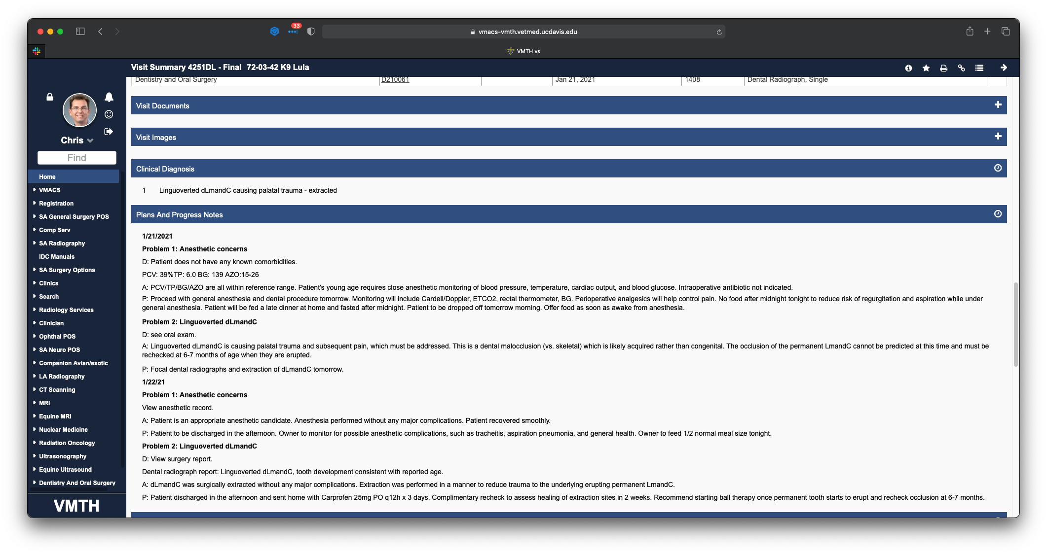

Slide 49
Self –Assessment – Are you ready?
Is your clinical diagnosis data stored discretely?
Can you change how it is collected/stored?
Are you looking to process retrospective data or just prospective?
Will Natural Language Processing do what you want?
Do you have the staff/expertise to perform this mapping?

