Slide 1
Information Behavior Studies to Improve Companion Animal Welfare
Niloofar Solhjoo
BSLIS, MS in Information Management, and PhD candidate, Information Systems
Victoria University of Wellington
School of Information Management
Pipitea Campus
23 Lambton Quay
Wellington, New Zealand

Slide 2
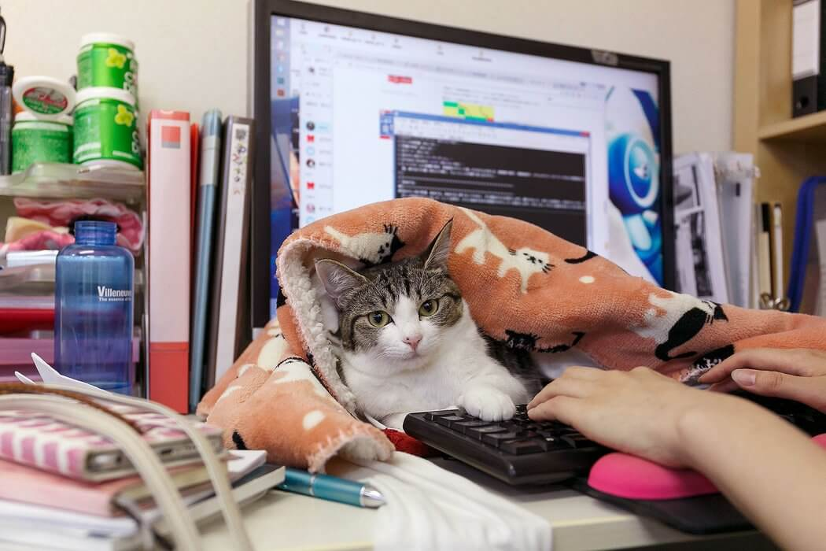
Introduction to Information Behavior (IB)
IB in pet guardianship context
Designing an information intervention for pet guardians
Information Experience, a new approach to understand pet care activities

Slide 3
Introduction to Information Behavior (IB)
IB in pet guardianship context
Designing an information intervention for pet guardians
Information Experience, a new approach to understand pet care activities

Slide 4
Introduction to Information Behavior (IB)
To study people’s engagement with information, there is a wide range of different concepts and approaches within LIS discipline
IB tries to understand how people need, seek, manage, give and use information in specific context or in relation to specific system
IB research follows either a system-centered or a user-centered approach
IB is sometimes defined as an area of study (umbrella) that encompasses all other information related phenomena
IB
information practice information seeking
information literacy
information experience

Slide 5
Sample Theories in IB studies: general
Kuhlthau's model of the information searching process
Kuhlthau, C. C. ( 2004). Seeking meaning: A process approach to library and information services. 2nd edition, Westport CT: Libraries Unlimited.

Slide 6
Sample Theories in IB studies: types of actions
Hektor's information activities
Hektor, A. (2001). What's the use: Internet and information behavior in everyday life. Linkoping, Sweden: Linkoping University. (Linkoping Studies in Arts and Science 240).

Slide 7
Sample Theories in IB studies: modes of actions
Bate’s Integrated Modes of Information Seeking
Bates, M. J. (2002). Toward an integrated model of information seeking and searching. The New Review of Information Behaviour Research, 3(1), 1-15.

Slide 8
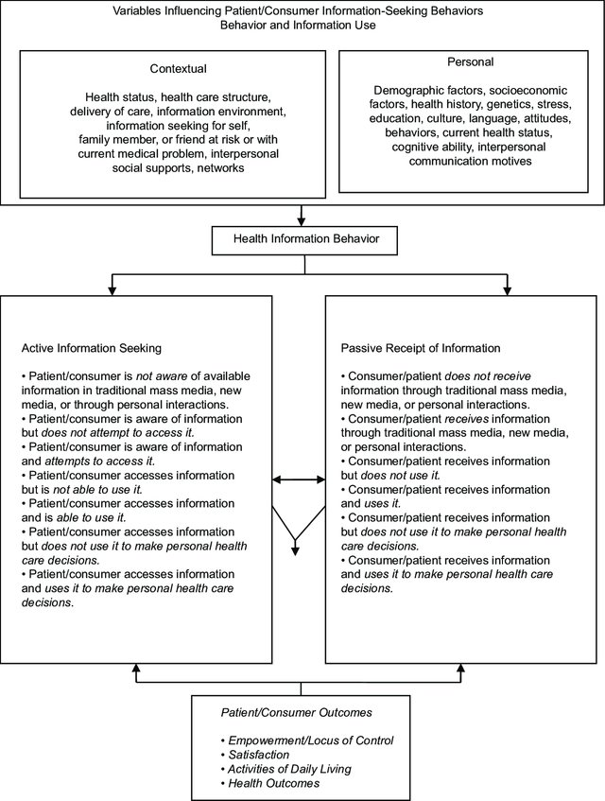
Sample Theories in IB studies: health context
Longo's expanded model of health information seeking behaviors
Longo, D. R. (2005). Understanding health information, communication, and information seeking of patients and consumers: a comprehensive and integrated model. Health expectations: an international journal of public participation in health care and health policy, 8(3), 189.

Slide 9
Sample Theories in IB studies: everyday life context
Fisher’s Information Grounds theory
Fisher, K. E., & Naumer, C. M. (2006). Information grounds: Theoretical basis and empirical findings on information flow in social settings. In New directions in human information behavior (pp. 93-111).

Slide 10
Quick exercise common pet related information behaviors
You want to acquire pet training tips, find a good diet for your pet, buy a pet product online, travel with your pet, decide whether to visit the vet or not, or know more about the transmission of COVID-19 to pet…
Information needs? Actions? Search strategies? Challenges and barriers? Sources?

Slide 11
Introduction to Information Behavior (IB)
IB in pet guardianship context
Designing an information intervention for pet guardians
Information Experience, a new approach to understand pet care activities

Slide 12
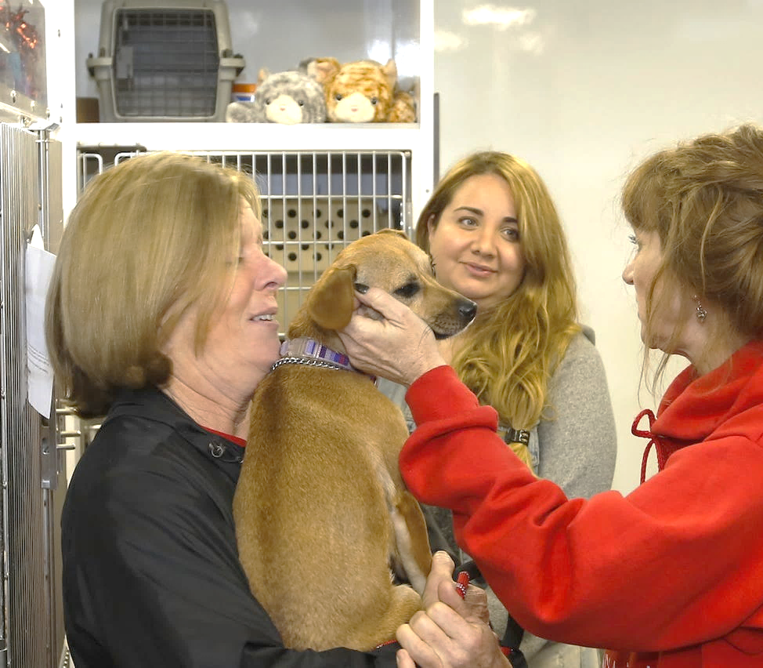
IB in pet guardianship context
The existing IB literature related to pet guardianship is mostly in health context
‘Pet health information’ covers both preventive health and health problem: information for keeping the pet well, preventing and managing pet diseases, identifying and accessing appropriate healthcare providers, and making any decisions related to pet health and healthcare.
Studies of pet health information could be divided into:
Health Information Seeking Behavior (HISB)
Health Information Literacy (HL)

Slide 13
IB studies could be seen as a baseline study or diagnostic in preparation for an IL intervention from which changes in IB could be monitored to indicate the outcome and impact of the intervention (Hepworth, Almehmadi et al. 2014).
Health Information Behavior
Goal: understand information behaviors
Health Information Literacy
Goal: understand information capabilities and change behaviors
Model: present an idealized, prescriptive set of steps
Model: identify actual behaviors and/or processes
Outcome: system and service design
Outcome: health literacy and learning programmes

Slide 14
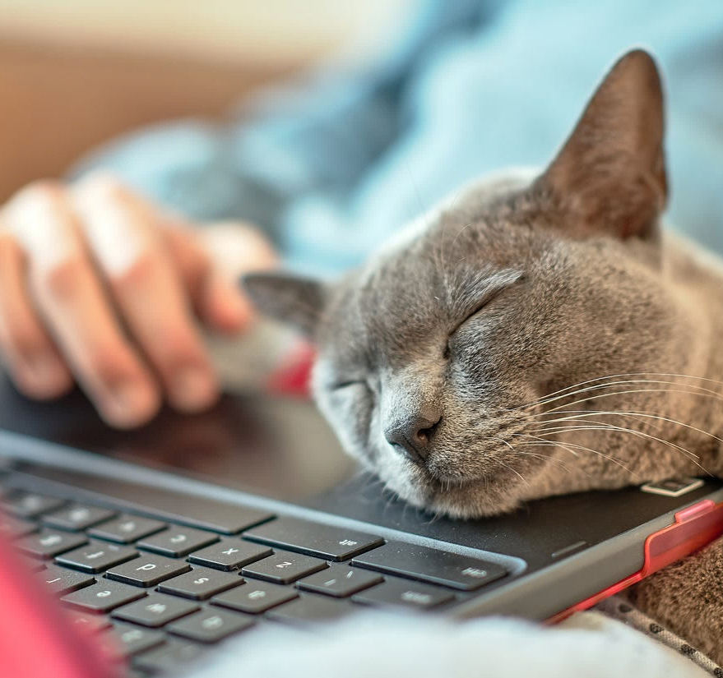
Pet Health information seeking behaviour (PHISB)
“an active effort of a guardian to obtain specific information in response to their pet health issue, or a passive receipt of pet health information that comes to a guardian in the course of daily life”
Low contribution of scholars from information field
Sample studies
PHISB on the internet (Kogan, Goldwaser et al. 2008, Kogan, Schoenfeld-Tacher et al. 2010, Kogan, Schoenfeld-Tacher et al. 2012, Davis 2015, Solhjoo, Naghshineh et al. 2017, Kogan, Oxley et al. 2018, Prata 2020, Lai, Khosa et al. 2021)
PHISB on social media (Store, Side et al. 2011, Oxley and Kogan 2018, Kogan, Hazel et al. 2019, Kogan, Little et al. 2021)
Veterinarians’ perception of PHISB (Kogan, Schoenfeld-Tacher et al. 2010 , King, Bechter et al. 2018, Küper and Merle 2020, Kogan and Oxley 2020, Lai, Khosa et al. 2021)

Slide 15
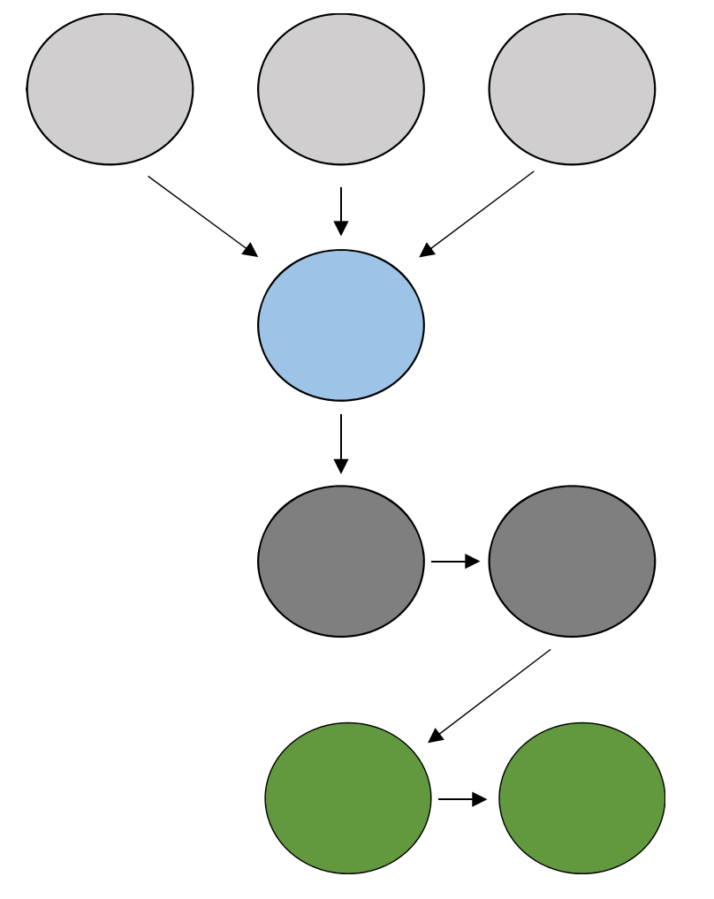
Health Literacy
Functional literacy
Communicative literacy
Critical
literacy
“the capacity of an individual to obtain, interpret, understand, and apply health information and services in ways that are health-enhancing”.
Health
literacy
Client empowerment
Self-efficacy
Pet care
Overall
Pet health
Health literacy model for veterinary practice (Shaw et al. 2017)

Slide 16
Health Literacy
Initiatives for veterinary practice:
evaluate the quality of pet health info (e.g. Murphy 2006, Taggart, Wardlaw et al. 2010, Royal, Sheats et al. 2018, Sheats, Royal et al. 2019, Sobolewski, Bryan et al. 2019, Baxter and Viera 2020)
measure guardians’ information skills
educate guardians’ how to evaluate pet health info (enhancing users’ information skills) (e.g. Kogan, Schoenfeld-Tacher et al. 2014, Solhjoo, Naghshineh et al. 2019)
provide pet health info (in veterinary consulting, and written communication) based on guardian’s health literacy level
more contribution of scholars from information field

Slide 17
Health Literacy
How to measure?
Quality of pet health info
Readability analysis: Flesch Kincaid readability scores, Grade Level scores, free readability calculators.
Trustworthiness assessment: adapting critical appraisal tools for assessing the quality of evidence, research or websites in veterinary fields. (e.g. Centre for Evidence-based Veterinary Medicine)
Pet owner’s health literacy
Self-report: scales and surveys (e.g. eHEALS, eHLQ )
Direct test: word recognition approach (e.g. METER), comprehension test (e.g. SAHL-S&E), performance-based tests (e.g. DHLI).
⚠️All are developed and applied in the human health care environment!
Go to the Health Literacy Tool Shed to find measurement tools.

Slide 18
“
There is a need to expand the body of health literacy by incorporating companion animal health for making the world a better place for many people and their pets.
“

Slide 19
Introduction to Information Behavior (IB)
IB in pet guardianship context
Designing an information intervention for pet guardians
Information Experience, a new approach to understand pet care activities

Slide 20
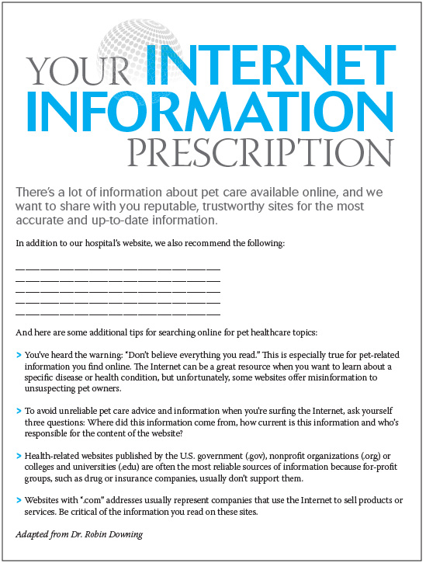
Information-based solutions for improving pet welfare
The most frequently used info intervention strategies in veterinary is information prescription (IP).
IPs are designed in the form of pamphlet and online material to modify and idealize information behaviors (e.g. Kogan, Schoenfeld-Tacher et al. 2014, and Solhjoo, Naghshineh et al. 2019)
Well designed interventions need standardized assessment tool, theory, or model to monitor or evaluate the effectiveness of the process.
An information prescription for veterinary clients, dvm360 (2014)

Slide 21
An Information Behaviour Intervention Model to Support Pet Welfare
Carer singularity
Carer-patient-professional interaction
Outcome
Dynamic variable
Veterinary- client relationship
Information intervention (e.g. Info Rx)
Background variables
Demographic characteristic
Health literacy level
Previous healthcare experiences
Health information seeking behaviour
Carer-Pet relationship
Pet health outcome
Satisfaction with information intervention
Pet health information evaluation skills
Self-efficacy for online pet health information seeking
Understanding pet health issues
Changing in pet owner’s health behaviour
Number of time client discussed online health information with vet
Pet Health Information Behavior Intervention (PHIBI) Model (Solhjoo, Naghshineh et al. 2018)

Slide 22
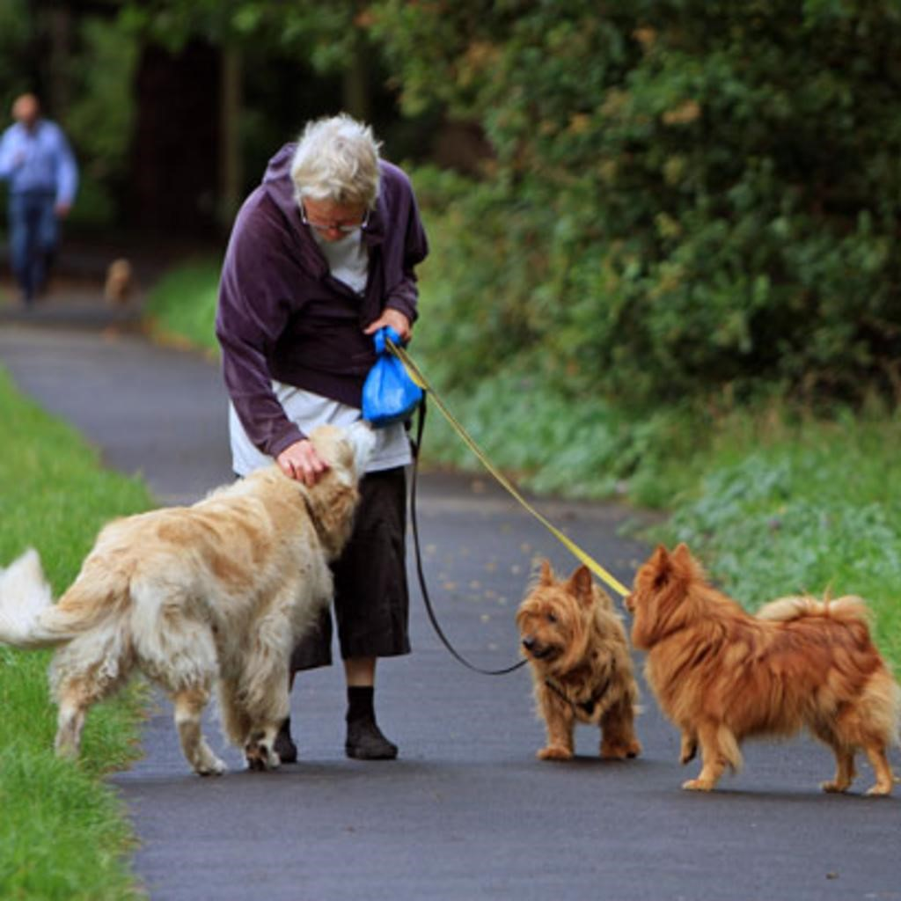
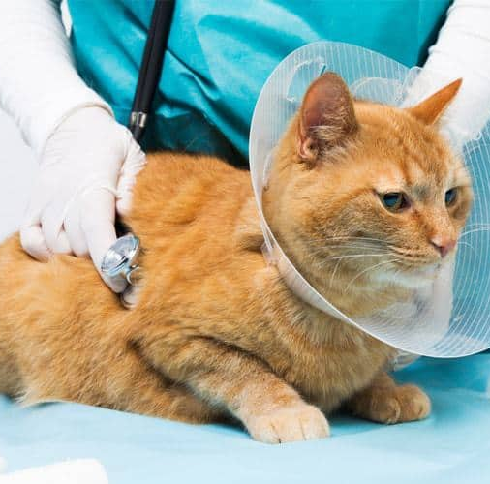
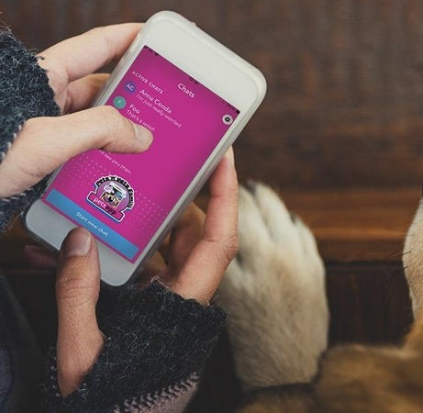
What elements should you consider in designing an info intervention program for veterinary’s clients?
Intrapersonal elements: client’s education and health literacy level,
Contextual elements: information seeking behavior, pet healthcare experiences, human-animal relationship, and client-veterinarian relationship.
Outcomes: instrumental (e.g. belief in one’s ability to seek online information and use Internet), communication (e.g. increase in communication with veterinarian about online pet health information), and learning (e.g. changes in healthcare behaviour or pet’s lifestyle)

Slide 23
Collaboration of information specialists with animal health sectors
understand elements related to guardians’ information behaviour (e.g. the relationship between health information seeking and the human-animal bond and the relationship-centered veterinary care);
design and evaluate intervention strategies for enhancing information skills among guardians (e.g. information therapy, client education program, and information prescription services).

Slide 24
Introduction to Information Behavior (IB)
IB in pet guardianship context
Designing an information intervention for pet guardians
Information Experience, a new approach to understand pet care activities

Slide 25
Theoretical turns that have occurred within LIS (Hartel 2019)
COGNITIVE TURN
AFFECTIVE TURN
NEO-DOCUMENTARY TURN
EMBODIED TURN
SOCIO-COGNITIVE TURN
SOCIAL CONSTRUCTIONIST TURN
EVERYDAY LIFE TURN
Can “Animal turn” be the next theoretical turn within LIS?

Slide 26
My PhD…
I am exploring how information shapes/is shaped by everyday pet care and management practices, and what is experienced as information across different facets of living with pets.
Human-Information Interactions
Pet-Related Information Experiences
Human- Animal Interactions
Bring animal turn into information research, in order to explore the richness of understanding about pet guardians’ information behaviors that involves multiple contexts, situations, spaces, actors, species, and activities.

Slide 27
Exploring pet care and management practices from an Information Experience (IE) perspective:
different from other information research paradigms (e.g., IB,and IL)
a holistic nature of engagement with information,
explores (a) people’s engagement with information in their experience, (b) what people experience as information and (c) how information is experienced
External
Receive
Interactions
Information
Information Experience
Internal
Interpret
Context
Spatial
Temporal
Solhjoo, Niloofar; et al. (Under review). Pets and people: information experiences in multispecies families. Journal of Documentation. 2021

Slide 28
Information- that could be in anything in the eyes of the individuals or groups who experience it;
External
Receive
Interactions
Information
Information Experience
these are lived experiences of interactions with information in the lifeworld (e.g., acquiring, interpretating, or understanding information)
Internal
Interpret
Context- a time-space container where information activities take place.
Context
Spatial
Temporal
Solhjoo, Niloofar; et al. (Under review). Pets and people: information experiences in multispecies families. Journal of Documentation. 2021

Slide 29
So what…?
As, IE studies connect with other human-cantered areas of information design, exploring information experience of pet care practices will have the practical contributions for:
healthcare providers who seek to improve both animal and human health;
educational campaigns for pet guardians that promote behaviour change programs;
information systems designers– whether a library program, or mobile app interface for pet guardians.
IE remains relatively emergent and has potential for further development. Exploring information experience of pet care practices would have the following theoretical contribution:
Grasp possibilities of the cooperation of nonhuman actors in shaping human information practices and spaces.
Development of the concept of embodied information about how human and pets understand each other and lived together.
Theorizing around the affective dimensions of engagement with information in the context of pet keeping

Slide 30
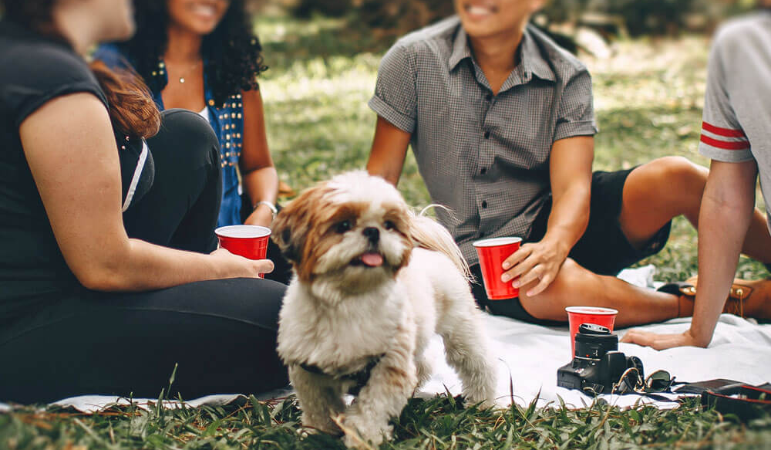
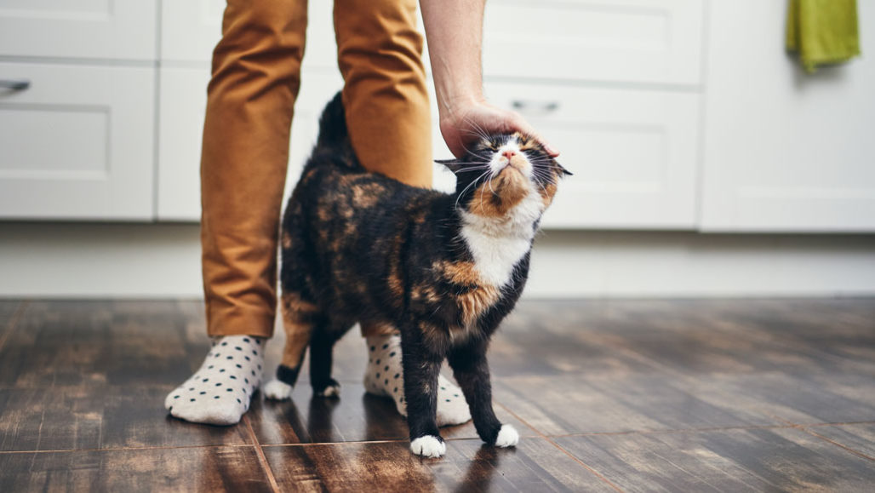
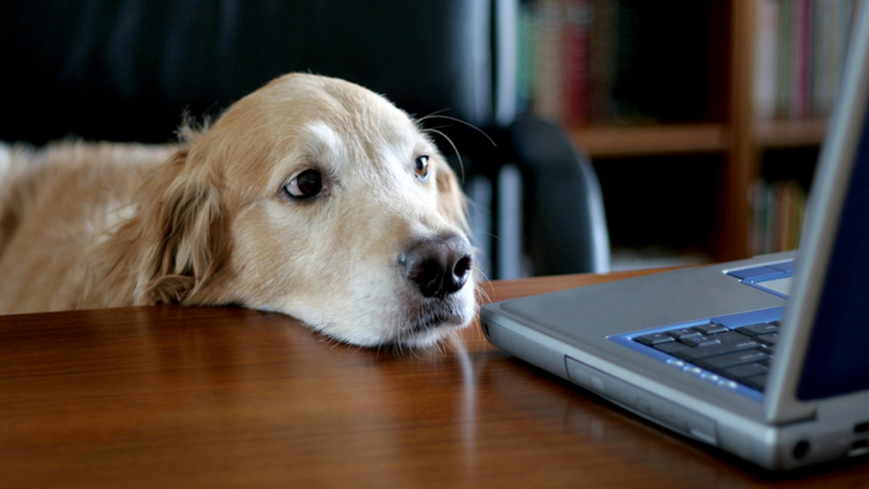
Wrap-up
Q&A

Slide 31
About the presenter
With an Information Science background, Niloofar Solhjoo is a young scholar from Iran passionate about companion animals. Since her Master’s degree in Information Management, she has focused on information behavior and information literacy of pet guardians. In 2020, Niloofar started her PhD in Information Systems as a Doctoral Scholarship recipient in the School of Information Management at the Victoria University of Wellington (VUW), NZ. She is researching on Information Experience (IE) with special interests in the human-companion animal interactions and their everyday shared lives. Due to COVID-19 pandemic she is studying by distance, hoping to travel to New Zealand by early 2022.
Since 2018 Niloofar has voluntary worked with different groups in animal health information field (e.g. the Association for Veterinary Informatics (AVI), the International Conference of Animal Health Information Specialists (ICAHIS), and the European Veterinary Libraries Group (EVLG). And now she is a member of the Association for Information Science and Technology (ASIS&T). She has published and reviewed papers about various aspects of online pet health information and information interventions targeting pet guardians.
Niloofar also has a background in qualitative research, and knowledge management. As an added bonus this information scientist can also do yoga and artistic swimming.
Contact Info: niloofar.Solhjoo@vuw.ac.nz

